Slide 3
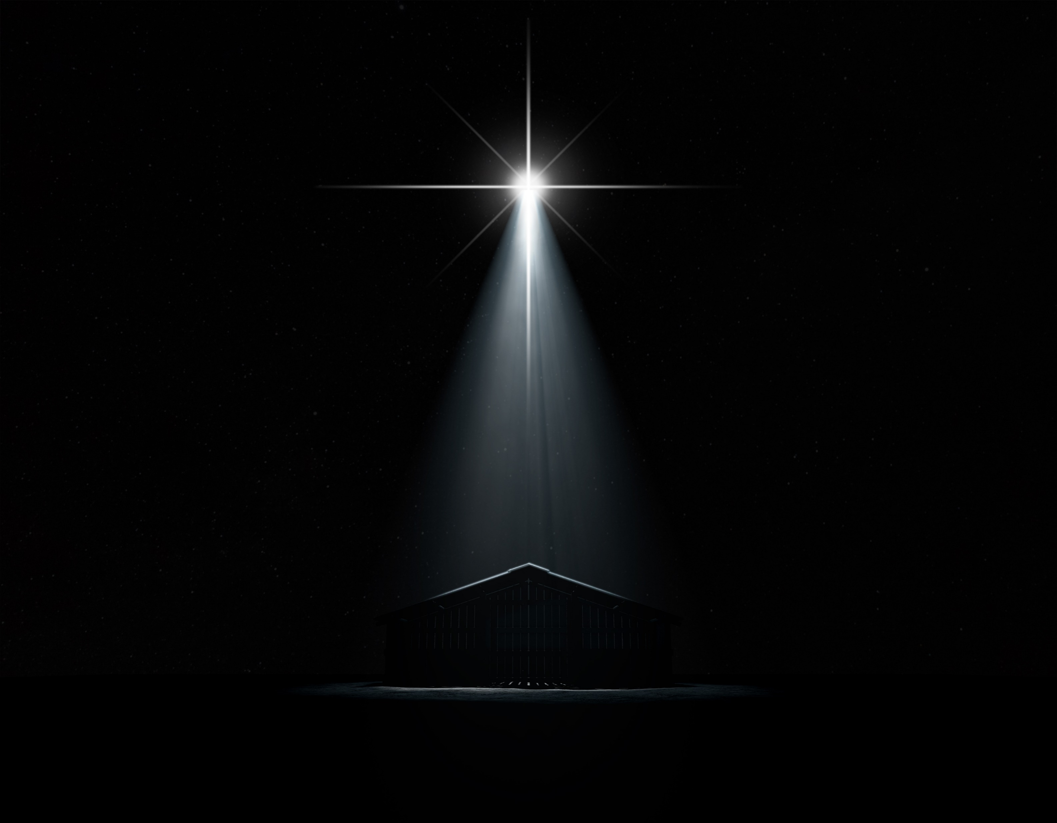
I
Immanuel -
God With Us
Alswart – Adobe Stock

Slide 4
“His name shall be called Immanuel, …God with us.” “The light of the knowledge of the glory of God” is seen “in the face of Jesus Christ.” From the days of eternity, the Lord Jesus Christ was one with the Father; He was “the image of God,” the image of His greatness and majesty, “the outshining of His glory.” It was to manifest this glory that He came to our world. To this sin-darkened earth he came to reveal the light of God’s love, to be “God with us.” Therefore, it was prophesied of Him, “His name shall be called Immanuel.” (DA 19.1)

Slide 5
II
The Incarnation
Alswart – Adobe Stock

Slide 6
Nearly two thousand years ago, a voice of mysterious import was heard in heaven, from the throne of God, “Lo, I come.” “Sacrifice and offering Thou wouldest not, but a body has Thou prepared Me…Lo, I come (in the volume of the Book it is written of Me.) to do Thy will, O God.” (Hebrews 10:5-7). In these words is announced the fulfillment of the purpose that had been hidden from eternal ages. Christ was about to visit our world, and to become incarnate…His divinity was veiled with humanity, the invisible glory in the visible human form.

Slide 7
Come, Thou Long Expected Jesus
Hymn 204
Charles Wesley | Rowland Hugh Prichard
Words: Public Domain; Music: Public Domain
Genotar - Shutterstock

Slide 8
Come, thou long expected Jesus!
Born to set thy people free;
From our fears and sins release us,
Let us find our rest in thee.
Verse 1

Slide 9
Israel’s strength and consolation,
Hope of all the earth Thou art;
Dear Desire of every nation,
Joy of every longing heart.
Verse 1

Slide 10
Born thy people to deliver,
Born a child and yet a King,
Born to reign in us forever,
Now Thy gracious kingdom bring.
Verse 2

Slide 11
By Thy own eternal spirit
Rule in all our hearts alone;
By Thy all sufficient merit,
Raise us to Thy glorious throne.
Verse 2

Slide 12
II
The Incarnation
Alswart – Adobe Stock

Slide 13
¹⁴ And the Word became flesh and dwelt among us, and we beheld His glory, the glory as of the only begotten of the Father, full of grace and truth…¹⁶ And of His fullness we have all received, and grace for grace. ¹⁷ For the law was given through Moses, but grace and truth came through Jesus Christ. (John 1:14, 16-17)

Slide 15
III
The Angel Appears to Mary
Alswart – Adobe Stock

Slide 16
Luke 1:26-29
²⁶ Now in the sixth month the angel Gabriel was sent by God to a city of Galilee named Nazareth, ²⁷ to a virgin betrothed to a man whose name was Joseph, of the house of David. The virgin’s name was Mary. ²⁸ And having come in, the angel said to her, “Rejoice, highly favored one, the Lord is with you; blessed are you among women!”
²⁹ But when she saw him, she was troubled at his saying, and considered what manner of greeting this was.

Slide 17
Luke 1:30-33
³⁰ Then the angel said to her, “Do not be afraid, Mary, for you have found favor with God. ³¹ And behold, you will conceive in your womb and bring forth a Son, and shall call His name Jesus. ³² He will be great, and will be called the Son of the Highest; and the Lord God will give Him the throne of His father David. ³³ And He will reign over the house of Jacob forever, and of His kingdom there will be no end.”

Slide 18
Luke 1:34-35
³⁴ Then Mary said to the angel, “How can this be, since I do not know a man?”
³⁵ And the angel answered and said to her, “The Holy Spirit will come upon you, and the power of the Highest will overshadow you; therefore, also, that Holy One who is to be born will be called the Son of God.

Slide 19
Luke 1:38, 46-48
³⁸ Then Mary said, “Behold the maidservant of the Lord! Let it be to me according to your word.” And the angel departed from her.
⁴⁶ And Mary said: “My soul magnifies the Lord,
⁴⁷ And my spirit has rejoiced in God my Savior.
⁴⁸ For He has regarded the lowly state of His maidservant;
For behold, henceforth all generations will call me blessed.

Slide 20
Notes:
When you click to the next slide the soundtrack will automatically begin.

Slide 22
IV
The Journey to Bethlehem
Alswart – Adobe Stock

Slide 23
Luke 2:1,3-5
¹ And it came to pass in those days that a decree went out from Caesar Augustus that all the world should be registered. ³ So all went to be registered, everyone to his own city.
⁴ Joseph also went up from Galilee, out of the city of Nazareth, into Judea, to the city of David, which is called Bethlehem, because he was of the house and lineage of David, ⁵ to be registered with Mary, his betrothed wife, who was with child.

Slide 24
The trip from Nazareth to Bethlehem was 90 miles. They must travel south along the flatlands of the Jordan, then west over the hills surrounding Jerusalem, then finally on into Bethlehem. ¹ “We have no idea how difficult it was” “In antiquity, the most we find people traveling is 20 miles a day. And this trip was very much uphill and downhill. It was not simple.”
¹ James F Strange Professor of Biblical Archeology

Slide 25
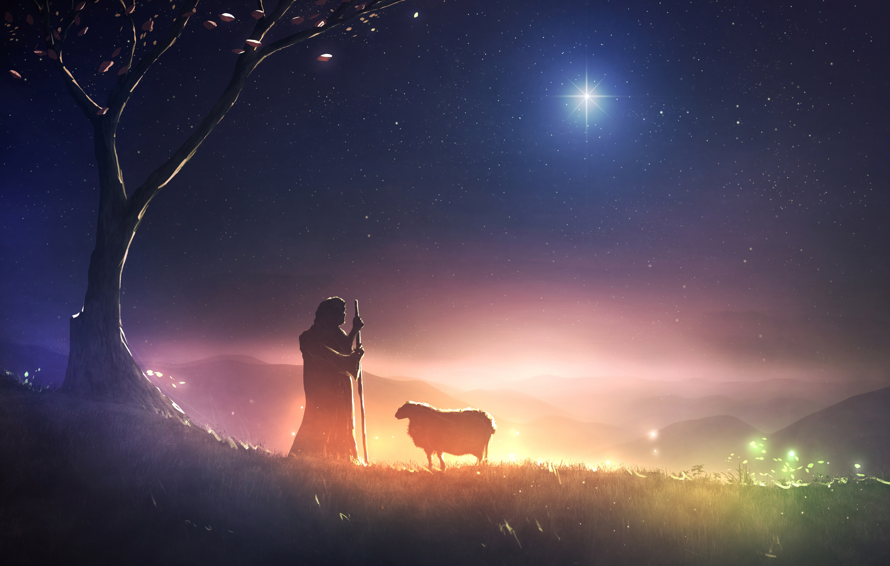
O Little Town of Bethlehem
Hymn 135
Lewis Henry Redner | Phillips Brooks
Words: Public Domain; Music: Public Domain
ChristianPhotoShops.com

Slide 26
O little town of Bethlehem,
How still we see thee lie!
Above thy deep and dreamless sleep the silent stars go by.
Verse 1

Slide 27
Yet in thy dark streets shineth
The everlasting Light;
The hopes and fears of all the years are met in Thee tonight.
Verse 1

Slide 28
For Christ is born of Mary,
And gathered all above, While mortals sleep, the angels keep Their watch of wondering love.
Verse 2

Slide 29
O morning stars together, Proclaim the holy birth!
And praises sing to God the King, And peace to men on earth.
Verse 2

Slide 30
How silently, how silently,
The wondrous Gift is given!
So God imparts to human hearts The blessings of His heav’n.
Verse 3

Slide 31
No ear may hear His coming,
But in this world of sin, Where meek souls will receive Him still, The dear Christ enters in.
Verse 3

Slide 32
O holy Child of Bethlehem, Descend to us, we pray;
Cast out our sin, and enter in,
Be born in us today.
Verse 4

Slide 33
We hear the Christmas angels
The great glad tidings tell;
O come to us, abide with us,
Our Lord Immanuel!
Verse 4

Slide 34
V
The Birth of Jesus
Alswart – Adobe Stock

Slide 35
When they finally arrived in Bethlehem no room could be found for them. No one knew that this was a Holy night, a Night like no other.
Alswart – Adobe Stock

Slide 36
Silent Night, Holy Night
Hymn 143
Franz Xaver Gruber | John Freeman Young | Joseph Mohr
Words: Public Domain; Music: Public Domain
PhotoGranary - Adobe Stock

Slide 37
Silent night, holy night,
All is calm, all is bright;
Round yon virgin mother
and Child!
Verse 1

Slide 38
Holy Infant so tender
and mild, Sleep in heavenly peace, Sleep in heavenly peace.
Verse 1

Slide 39
Silent night, holy night,
Darkness flies, all is light;
Shepherds hear the
angels sing,
Verse 2

Slide 40
“Alleluia! hail the King!
Christ, the Savior is born,
Christ, the Savior
is born.”
Verse 2

Slide 41
Silent night, holy night,
Son of God, love’s pure light;
Radiant beams from Thy
holy face,
Verse 3

Slide 42
With the dawn of redeeming grace, Jesus, Lord, at Thy birth, Jesus, Lord, at
Thy birth.
Verse 3

Slide 43
Silent night, holy night,
Wondrous star, lend thy light; With the angels let
us sing,
Verse 4

Slide 44
Alleluia to our King;
Christ, the Savior is born,
Christ, the Savior
is born.
Verse 4

Slide 45
V
The Birth of Jesus
Alswart – Adobe Stock

Slide 46
Luke writes: ⁶ So it was, that while they were there, the days were completed for her to be delivered. ⁷ And she brought forth her firstborn Son, and wrapped Him in swaddling cloths, and laid Him in a manger, because there was no room for them in the inn. (Luke 2:6-7)
Alswart – Adobe Stock

Slide 47
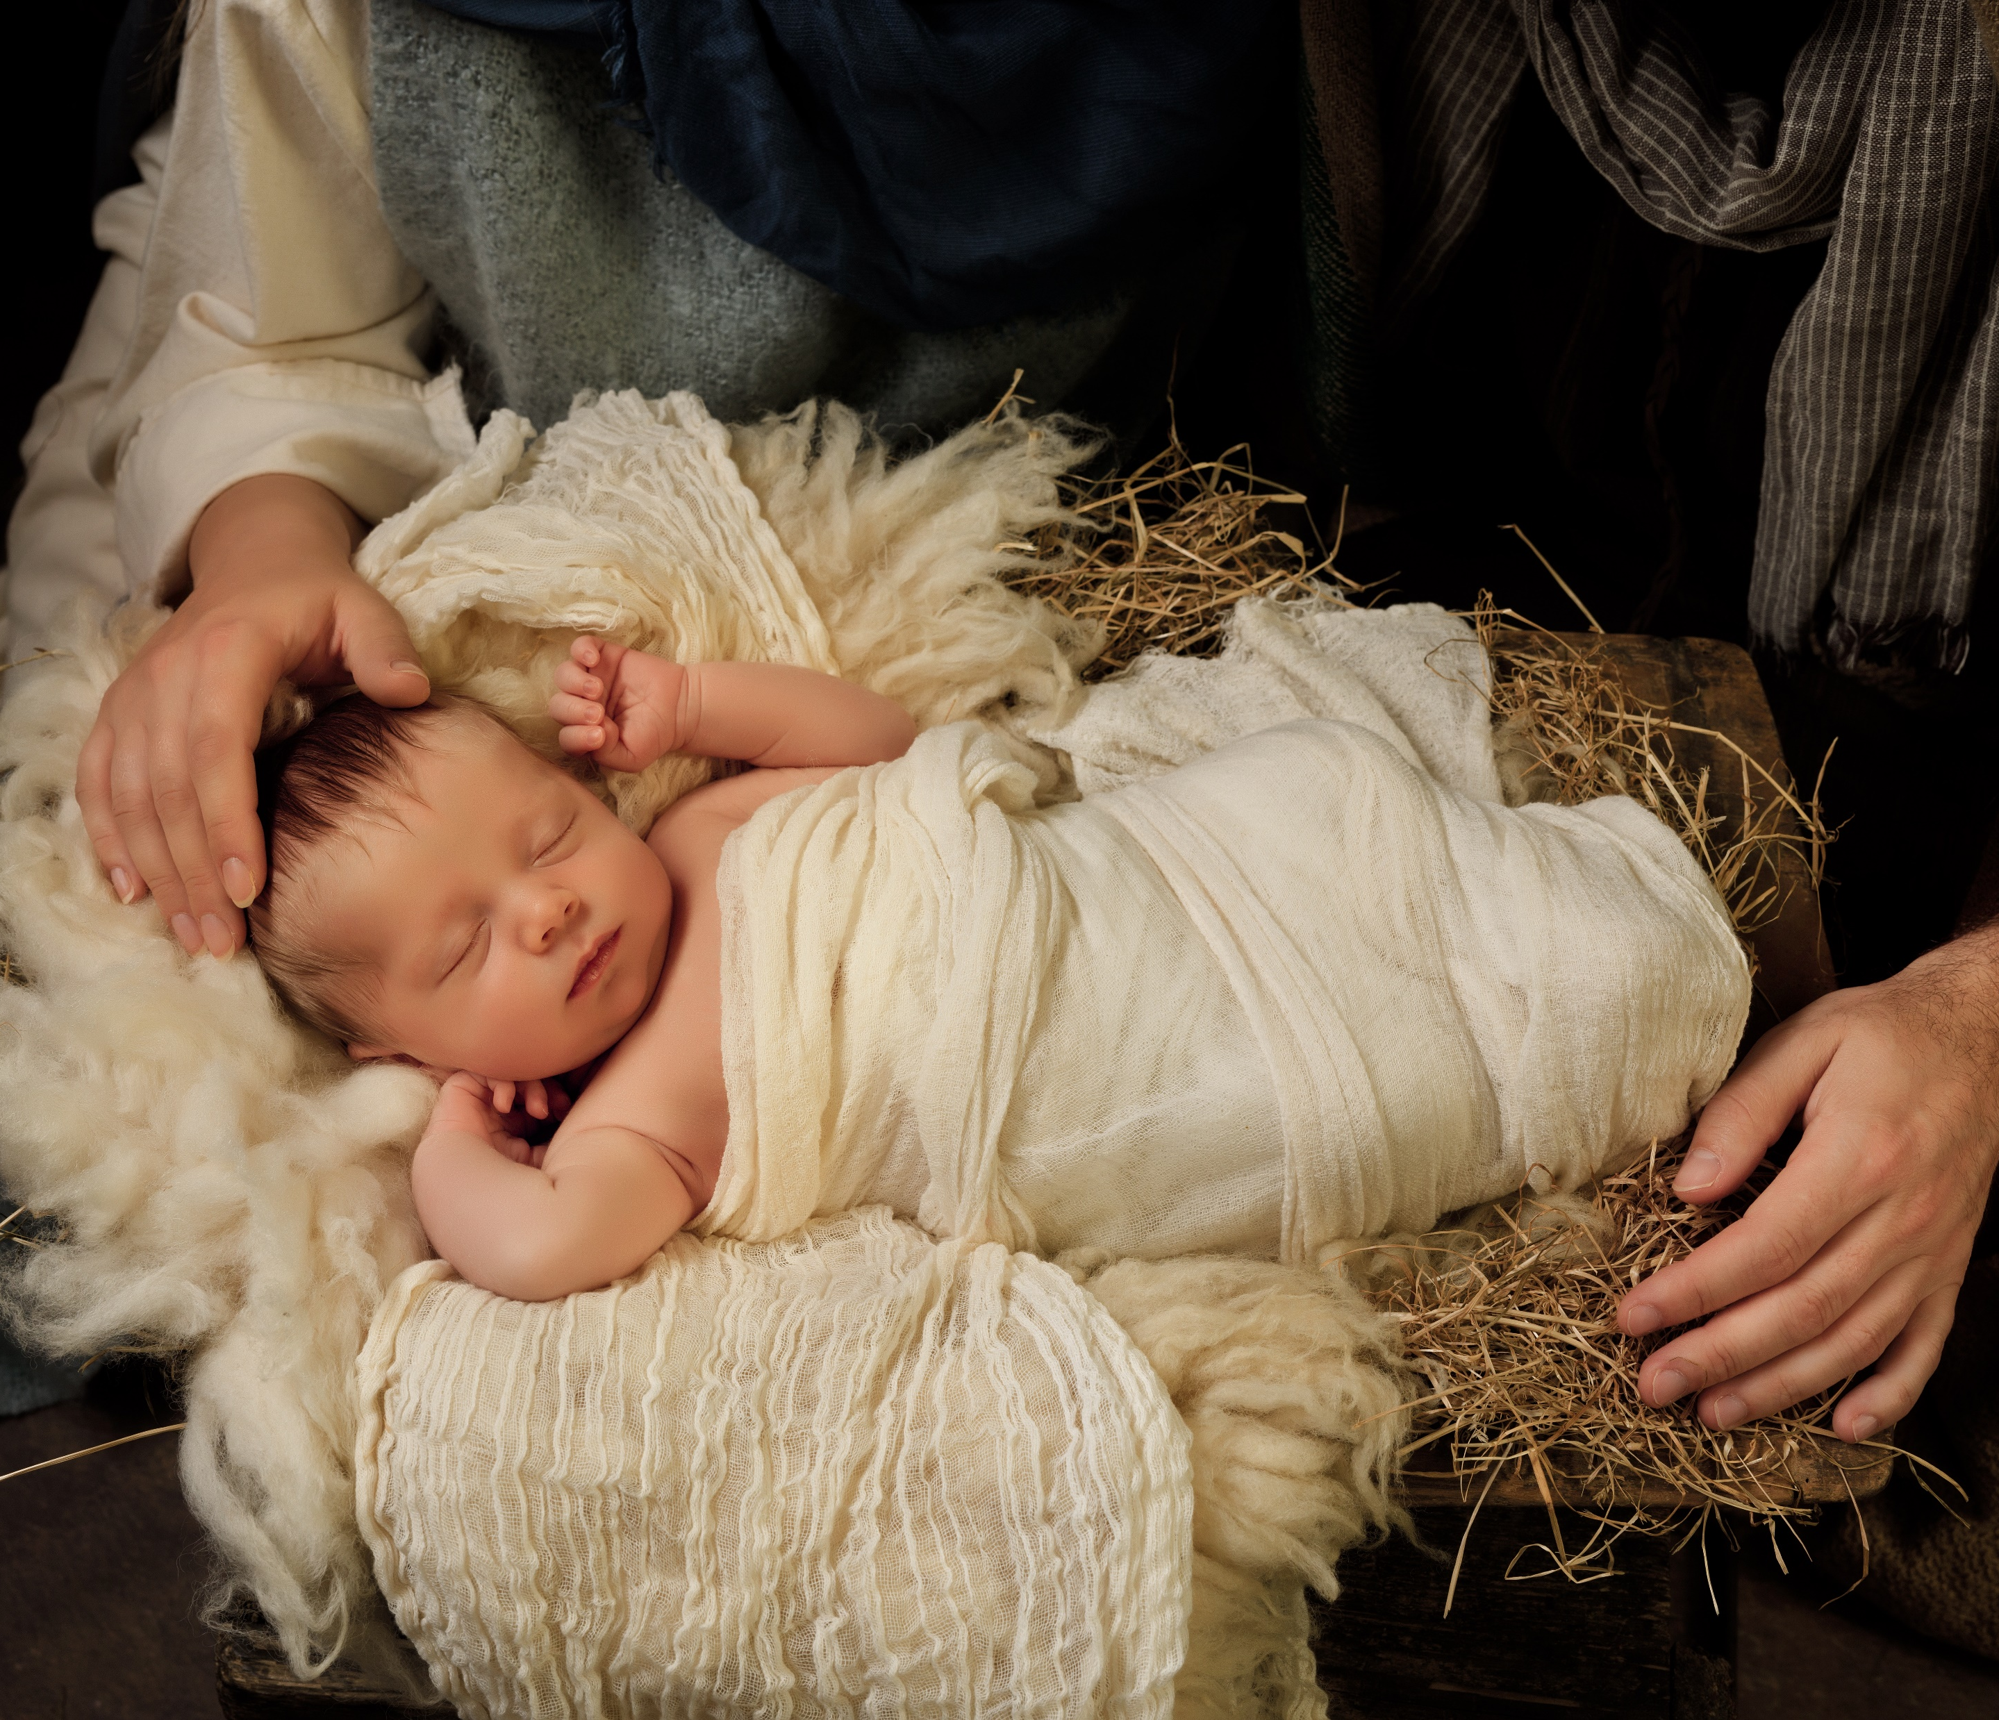
Away in a Manger
Hymn 124
James Ramsey Murray | John Thomas McFarland | Martin Luther
Words: Public Domain; Music: Public Domain
Anneke – Adobe Stock

Slide 48
Away in a manger, no crib
for a bed, The little Lord
Jesus, laid down His
sweet head.
Verse 1

Slide 49
The stars in the sky looked down where He lay,
The little Lord Jesus asleep
on the hay.
Verse 1

Slide 50
The cattle are lowing, the
Baby awakes,
But little Lord Jesus no
crying He makes.
Verse 2

Slide 51
I love Thee, Lord Jesus! look down from the sky,
And stay by my cradle till morning is nigh.
Verse 2

Slide 52
Be near me, Lord Jesus;
I ask Thee to stay
Close by me forever, and
love me, I pray.
Verse 3

Slide 53
Bless all the dear children in Thy tender care,
And fit us for heaven, to live with Thee there.
Verse 3

Slide 54
VI
The Angels Appear to
the Shepherds
Alswart – Adobe Stock

Slide 55
⁸ Now there were in the same country shepherds living out in the fields, keeping watch over their flock by night. ⁹ And behold, an angel of the Lord stood before them, and the glory of the Lord shone around them, and they were greatly afraid.
¹⁰ Then the angel said to them, “Do not be afraid, for behold, I bring you good tidings of great joy which will be to all people. ¹¹ For there is born to you this day in the city of David a Savior, who is Christ the Lord. (Luke 2:8-11)

Slide 56
¹² And this will be the sign to you: You will find a Babe wrapped in swaddling cloths, lying in a manger.”
¹³ And suddenly there was with the angel a multitude of the heavenly host praising God and saying:
¹⁴ “Glory to God in the highest, And on earth peace, goodwill toward men!” (Luke 2:12-14)

Slide 57
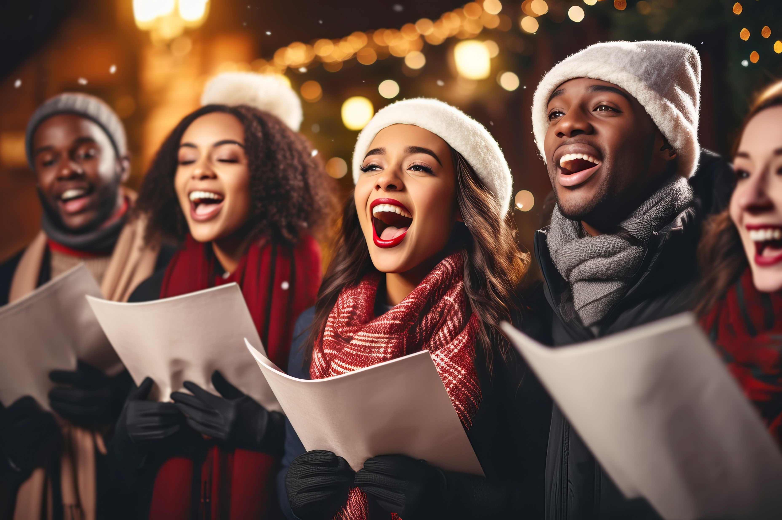
Hark! The Herald Angels Sing
Hymn 122
Charles Wesley | Felix Mendelssohn-Bartholdy
Words: Public Domain; Music: Public Domain
colnihko - Adobe Stock

Slide 58
Hark! the herald angels sing,
“Glory to the new born King,
Peace on earth, and mercy mild,
God and sinners reconciled!”
Verse 1

Slide 59
Joyful, all ye nations rise,
Join the triumph of the skies;
With th’ angelic host proclaim,
“Christ is born in Bethlehem!”
Verse 1

Slide 60
Hark! the herald angels sing,
“Glory to the new born King!”
Refrain

Slide 61
Christ, by highest heaven adored; Christ, the everlasting Lord; In the manger born a king, While adoring angels sing,
Verse 2

Slide 62
“Peace on earth, to men good will;” Bid the trembling soul be still, Christ on earth has come to dwell, Jesus, our Immanuel!
Verse 2

Slide 63
Hark! the herald angels sing,
“Glory to the new born King!”
Refrain

Slide 64
Hail! the heaven-born Prince of Peace! Hail! the Sun of Righteous-ness! Light and life to all He brings, Risen with healing in His wings.
Verse 3

Slide 65
Mild He lays His glory by,
Born that man no more may die,
Born to raise the sons of earth,
Born to give them second birth.
Verse 3

Slide 66
Hark! the herald angels sing,
“Glory to the new born King!”
Refrain

Slide 67
VI
The Angels Appear to
the Shepherds
Alswart – Adobe Stock

Slide 68
¹⁵ So it was, when the angels had gone away from them into heaven, that the shepherds said to one another, “Let us now go to Bethlehem and see this thing that has come to pass, which the Lord has made known to us.” ¹⁶ And they came with haste and found Mary and Joseph, and the Babe lying in a manger. (Luke 2:15-16)
Alswart – Adobe Stock

Slide 69
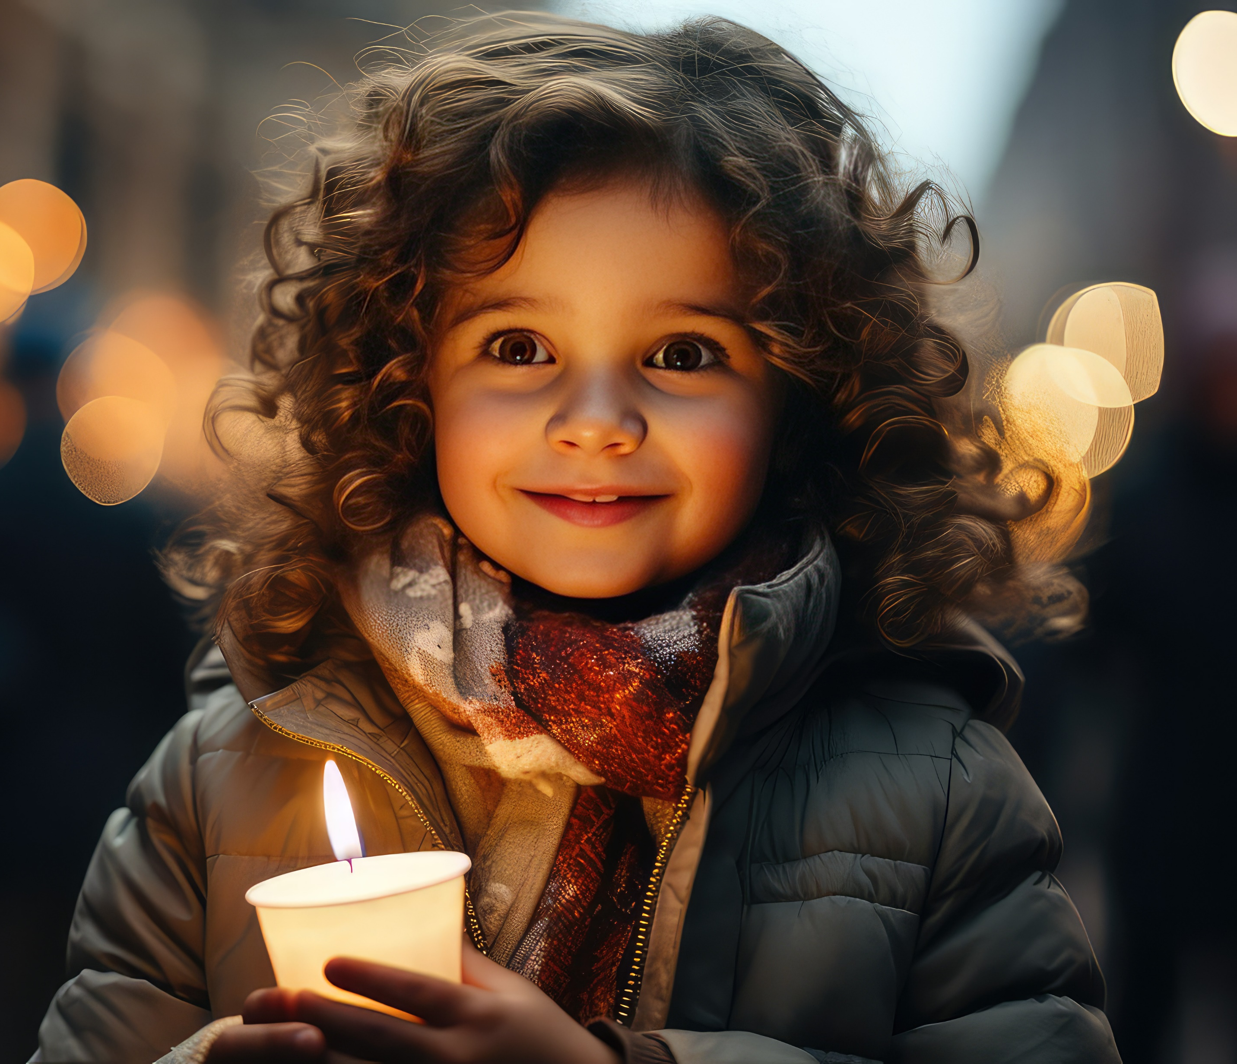
O Come, All Ye Faithful
Hymn 132
C. Frederick Oakeley | John Francis Wade
Words: Public Domain; Music: Public Domain
SnowElf - Adobe Stock

Slide 70
O come, all ye faithful, joyful and triumphant, O come ye, O come ye to Bethlehem! Come and behold Him, born the King of angels!
Verse 1

Slide 71
O come, let us adore Him,
O come, let us adore Him,
O come, let us adore Him,
Christ, the Lord!
Refrain

Slide 72
Sing, choirs of angels, sing in exultation, O sing all ye citizens of heaven above! Glory to God, all glory in the highest!
Verse 2

Slide 73
O come, let us adore Him,
O come, let us adore Him,
O come, let us adore Him,
Christ, the Lord!
Refrain

Slide 74
Yea, Lord, we greet Thee, born this happy morning, Jesus, to Thee be all glory given; Word of the Father, now in flesh appearing!
Verse 3

Slide 75
O come, let us adore Him,
O come, let us adore Him,
O come, let us adore Him,
Christ, the Lord!
Refrain

Slide 76
VII
The Commission
Alswart – Adobe Stock

Slide 77
¹⁷ Now when they had seen Him, they made widely known the saying which was told them concerning this Child. (Luke 2:17)
We all have the opportunity to make it widely known that Jesus has come! Will you join us in proclaiming the Good News!
Alswart – Adobe Stock

Slide 78
¹⁸ And all those who heard it marveled at those things which were told them by the shepherds. ¹⁹ But Mary kept all these things and pondered them in her heart. (Luke 2:18-19)
Alswart – Adobe Stock

Slide 79
Sermon
Speaker
Alswart – Adobe Stock

Slide 81
VII
The Commission
Alswart – Adobe Stock

Slide 82
²⁰ Then the shepherds returned, glorifying and praising God for all the things that they had heard and seen, as it was told them. (Luke 2:20)
Alswart – Adobe Stock

Slide 83
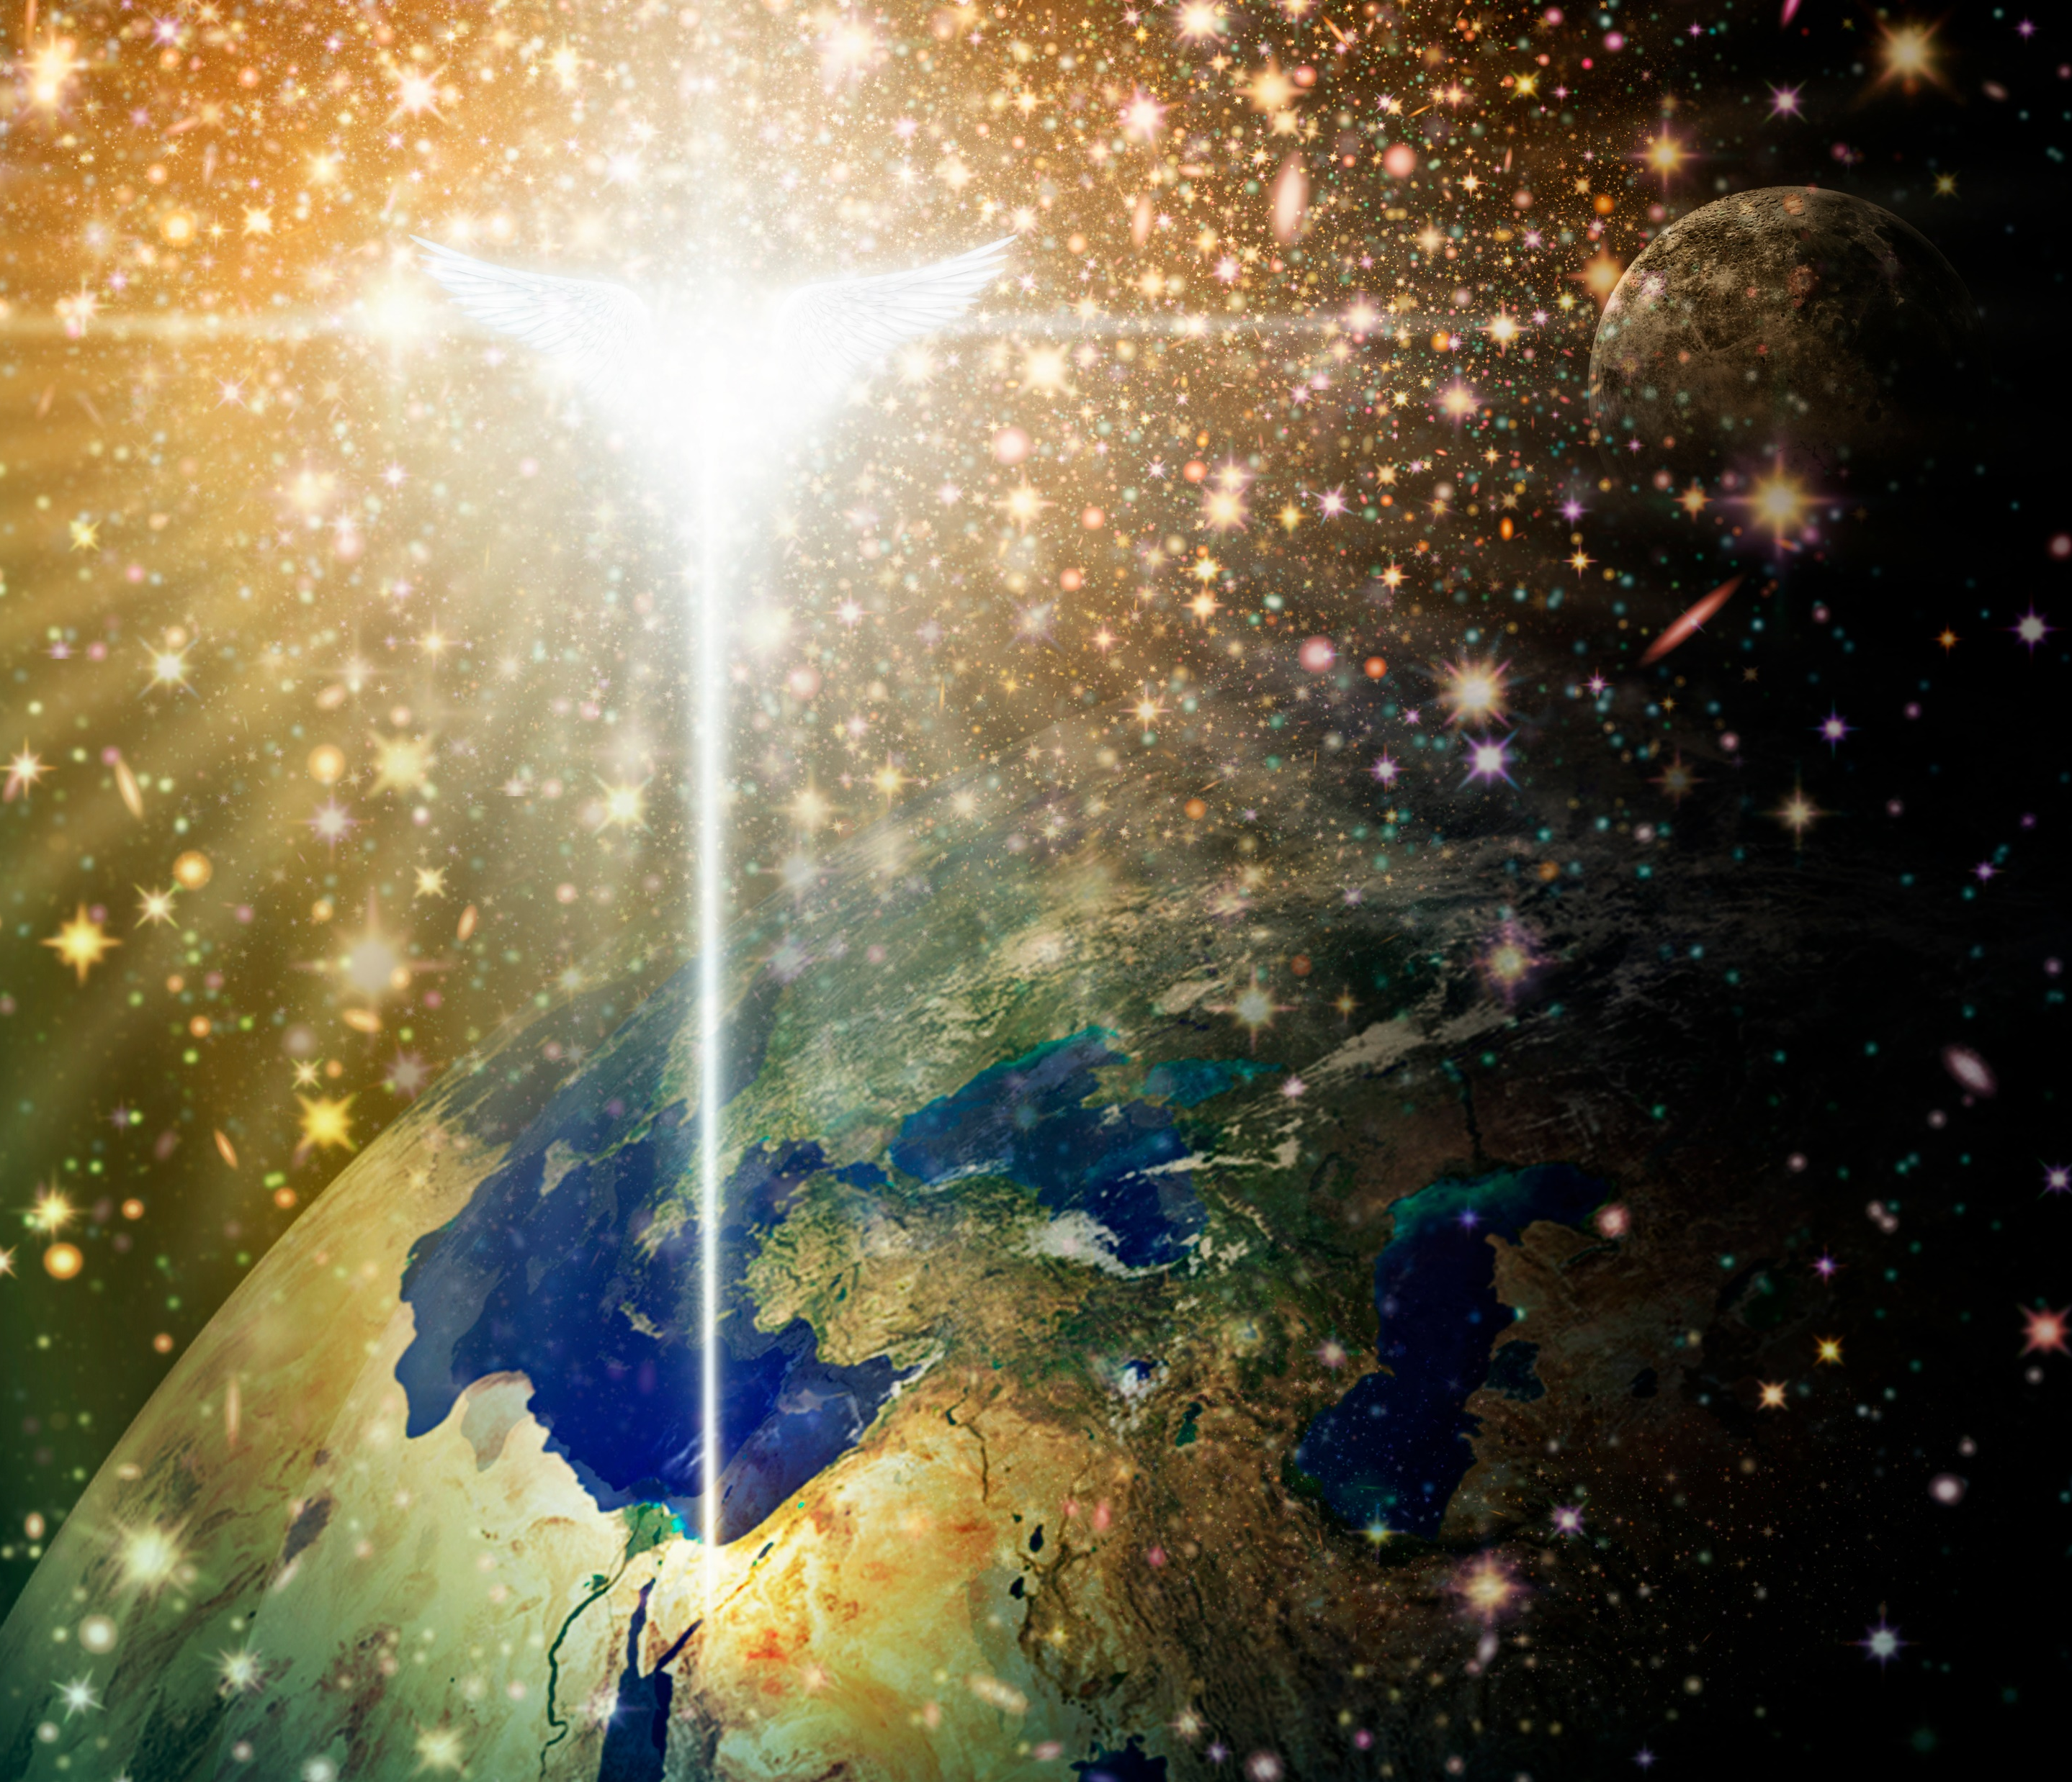
Joy to the World
Hymn 125
George Frideric Handel | Isaac Watts
Words: Public Domain; Music: Public Domain
Jim Larkin - Shutterstock

Slide 84
Joy to the world, the Lord is come! Let earth receive her King; Let every heart prepare Him room,
Verse 1

Slide 85
And heaven and nature sing,
And heaven and nature sing,
And heaven, and heaven and nature sing.
Verse 1

Slide 86
Joy to the earth, the Savior reigns! Let men their songs employ; While fields and floods, rocks, hills, and plains,
Verse 2

Slide 87
Repeat the sounding joy,
Repeat the sounding joy,
Repeat, repeat the
sounding joy.
Verse 2

Slide 88
No more let sin and sorrow grow, Nor thorns infest the ground; He comes to make His blessings flow
Verse 3

Slide 89
Far as the curse is found,
Far as the curse is found,
Far as, far as the curse
is found.
Verse 3

Slide 90
He rules the world with truth and grace, And makes the nations prove, The glories of
His righteousness,
Verse 4

Slide 91
And wonders of His love,
And wonders of His love,
And wonders, and wonders
of His love.
Verse 4

